Slide 1
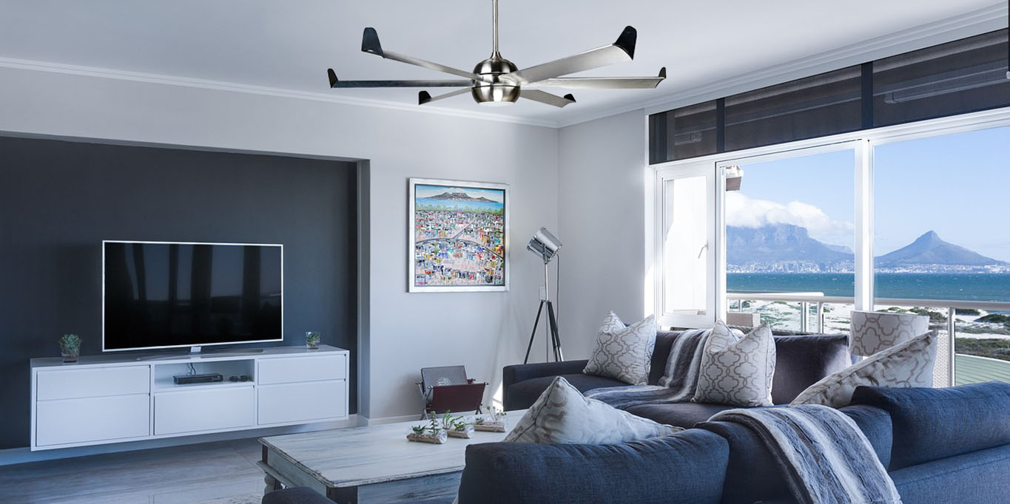
WELCOME
To E-Project Presentation

Slide 2
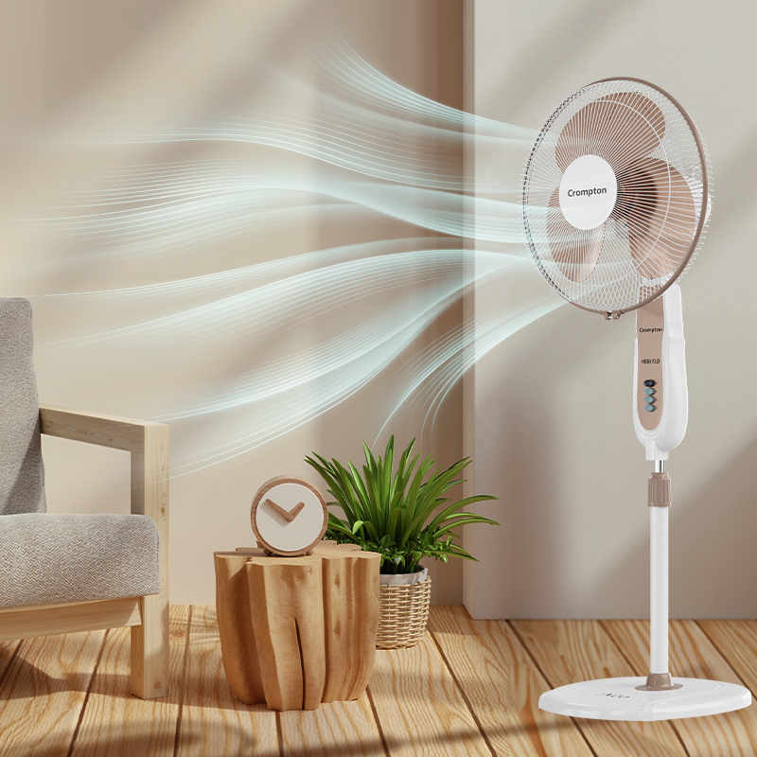

FANoFAN
Supervisor Name:
Sir Usama Riaz
Co-ordinator Name:
Miss Munazza

Slide 3
E-Project
FANoFAN Presentators
Maheen Sherazi
Student Id : 1530873
Hafza Gul
Student Id : 1530874
Noor Bibi
Student Id : 1530871
Ansa Sherazi
Student Id : 1530872

Slide 4
INTRODUCTION
FANoFAN:
At FANoFAN, we specialize in providing a diverse selection of high-quality electric fans designed to meet all your cooling needs. Our range includes stylish ceiling fans, convenient table fans, efficient exhaust fans, versatile bracket fans, and advanced inverter fans. We also offer remote-controlled fans and energy-saving models to ensure maximum comfort and efficiency. Explore FANoFAN today and discover the perfect fan that combines performance, elegance, and innovative technology for your home or office.
OBJECTIVE
Our Objective:
At FANoFAN, our mission is to enhance your living and working spaces with the perfect blend of comfort, efficiency, and style. We aim to provide a wide variety of innovative and high-performance electric fans that cater to your specific needs. By combining cutting-edge technology with elegant designs, we strive to offer products that not only cool your environment but also save energy and add aesthetic value to your surroundings. Join us in our journey to create a cooler, more comfortable world with FANoFAN.

Slide 5
PROBLEM STATEMENT
Statement:
FANoFAN Company is into manufacturing and selling on Fans. They manufacture fans for various needs of customers. From Ceiling Fans to Table Fans to Exhaust Fans, they are into all types of Fan Manufacturing.
They are looking to come up with their own website and display all the products available with them. They want to provide a detailed information about all their products.
REQUIRMENTS
Requirments:
The Web site is to be created based on the following requirements.
The Home Page should be created making use of Sections with a suitable logo, the header section can be added which will show images Fans.
2. The site must contain the links to navigate through any category for the information.
3. Links of bottles can be categorized like (Ceiling Fans, Table Fans, Exhaust etc.)
4. Specification and Pricing of Fans can be added along with the images.
5. Gallery section can be added for viewing different images.
6. Feedback must be allowed to enter by the viewer
7. Site map, Gallery, about us, Queries link, Contact us link must be added.
8. The complete description must be allowed to get download as pdf or doc file.
9. The advertise section with various facilities provided should be mentioned.

Slide 6
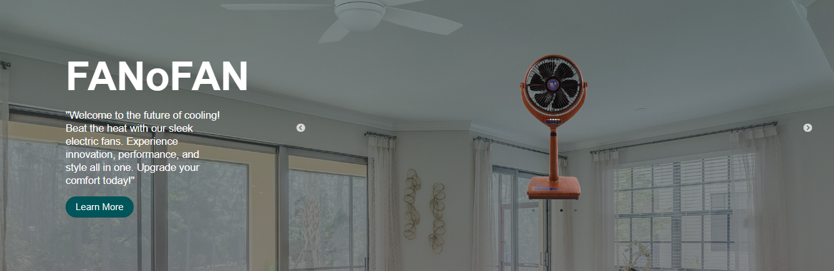
NAVBAR
CAROUSEL

Slide 7
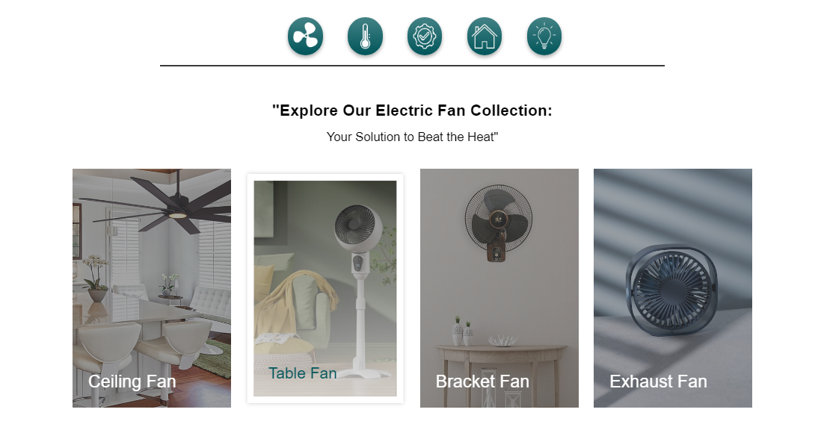
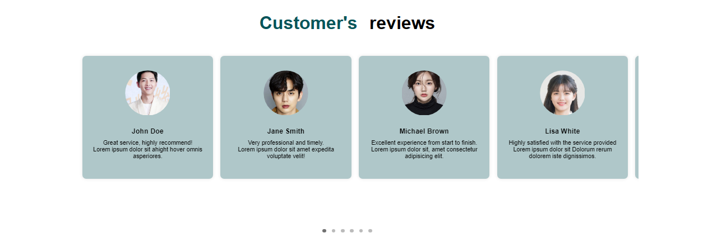
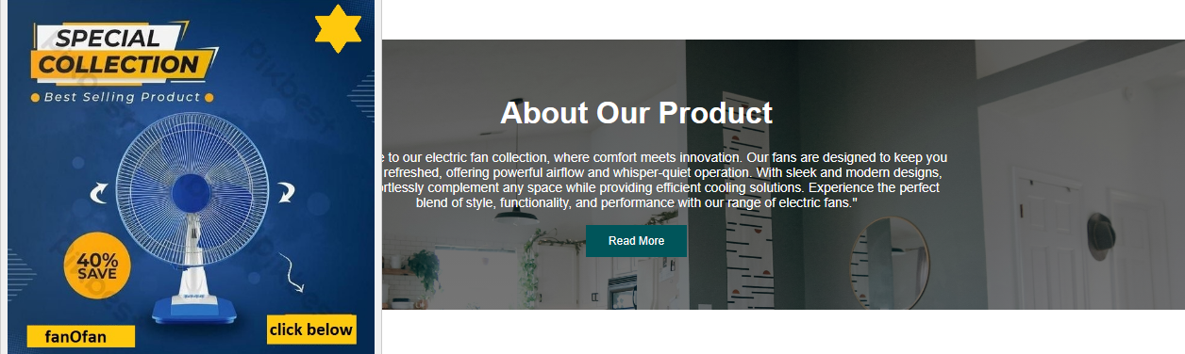
CATEGORY
SLIDER
ADVERTISING

Slide 8
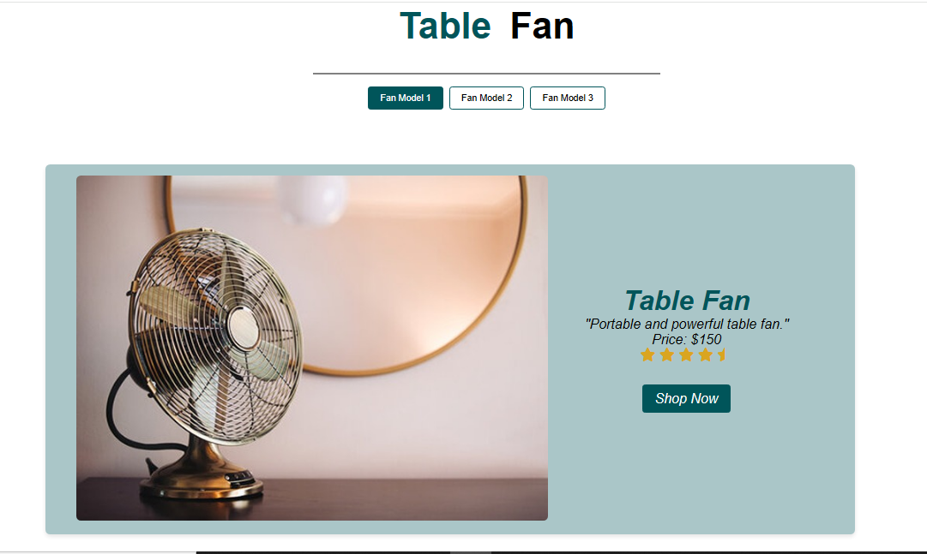
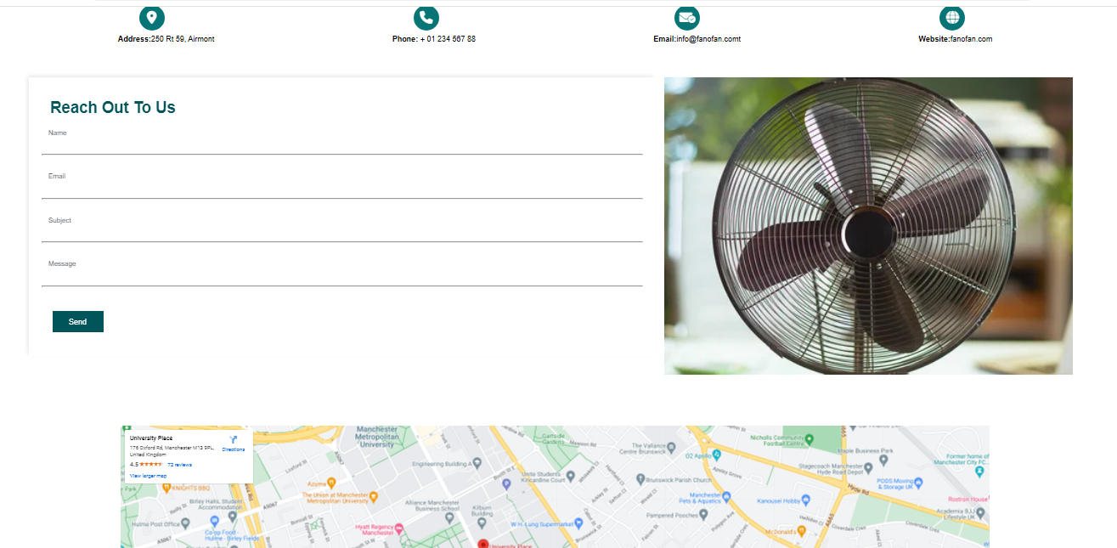
TAB GALLERY PAGE
CONTECT PAGE

Slide 9
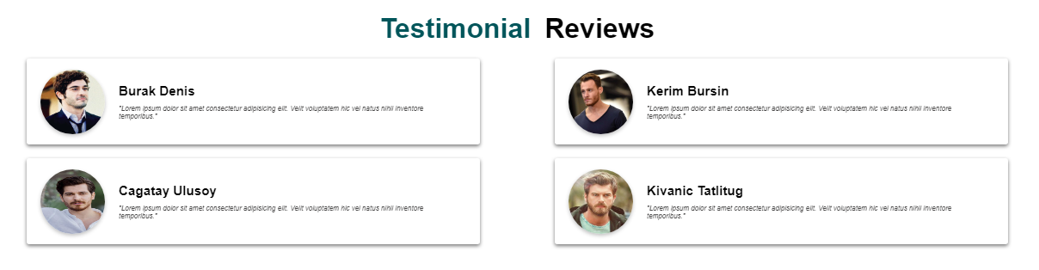
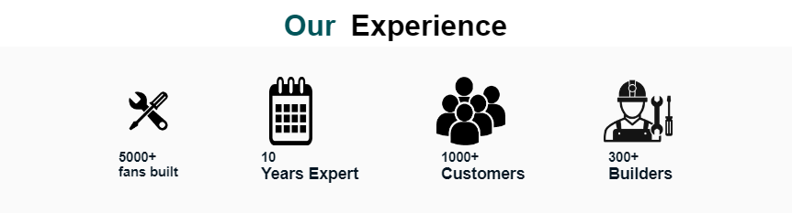
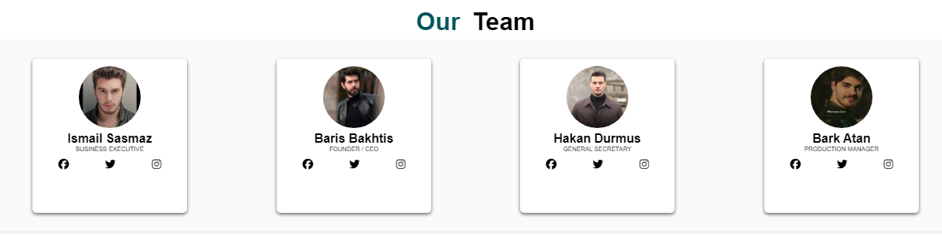
TESTIMONIAL
EXPERIENCE
TEAM

Slide 10
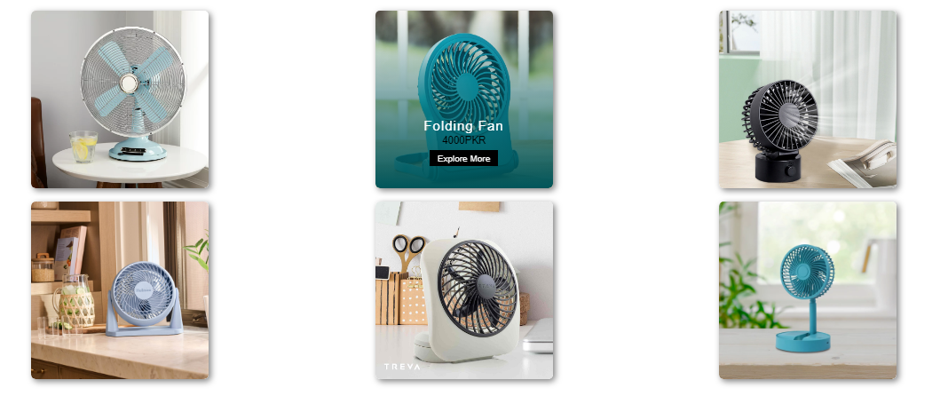
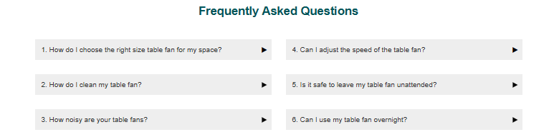

CARD HOVER
FAQ
FOOTER

Slide 11
THANK YOU
For YOUR Attention

